Slide 1
Machine Learning
Yiming li
Tianyu Qu

Slide 2
Introduction
Risk Ranking: assessment of individual financial risk using different personal data features
A total of 20 features are available for analysis.
A classifier question：low, medium, high

Slide 3
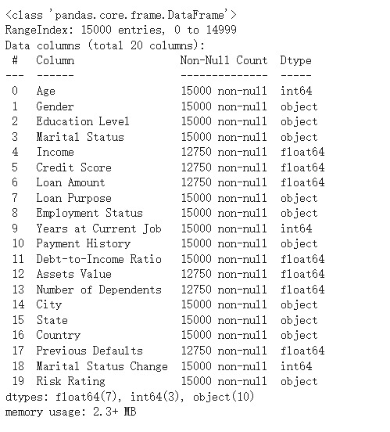
Data profiling
Notice some meaningless features.
Delete the column
Notice some feature types are object
One Hot Encoding and Ordinal Encoding
Notice it has some missing value
Use Pairwise deletion and mean Imputation
Notice some features needs binning

Slide 4
Data Preprocessing
Drop Irrelevant Columns
Remove unnecessary columns, such as ‘City’ and ‘State’

Slide 5
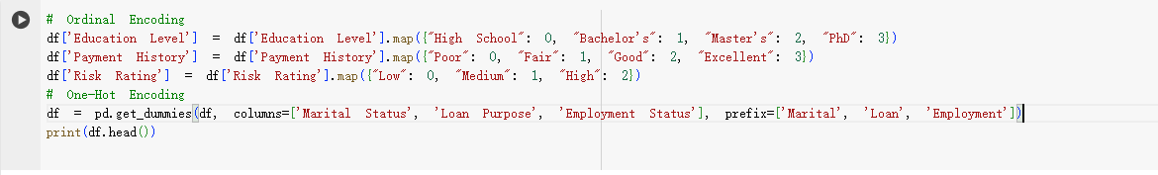
Data Preprocessing
Encoding categorical to numeric
Use Pairwise Deletion and Mean Imputation

Slide 6
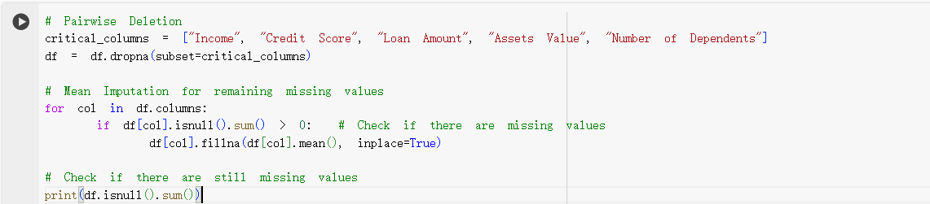
Data Preprocessing
Handling missing data
Pairwise deletion and Mean Imputation

Slide 7
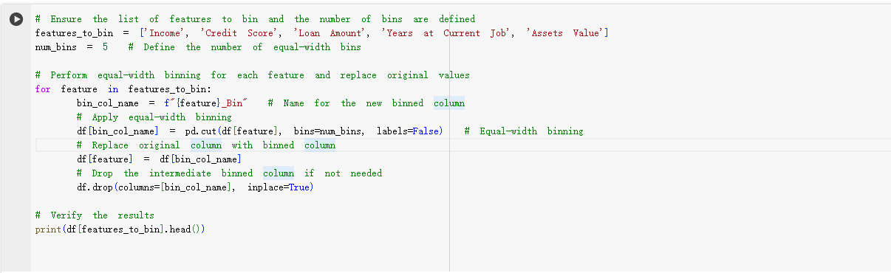
Data Preprocessing
Data Binning
Equal-width binning and replace with binning column

Slide 8
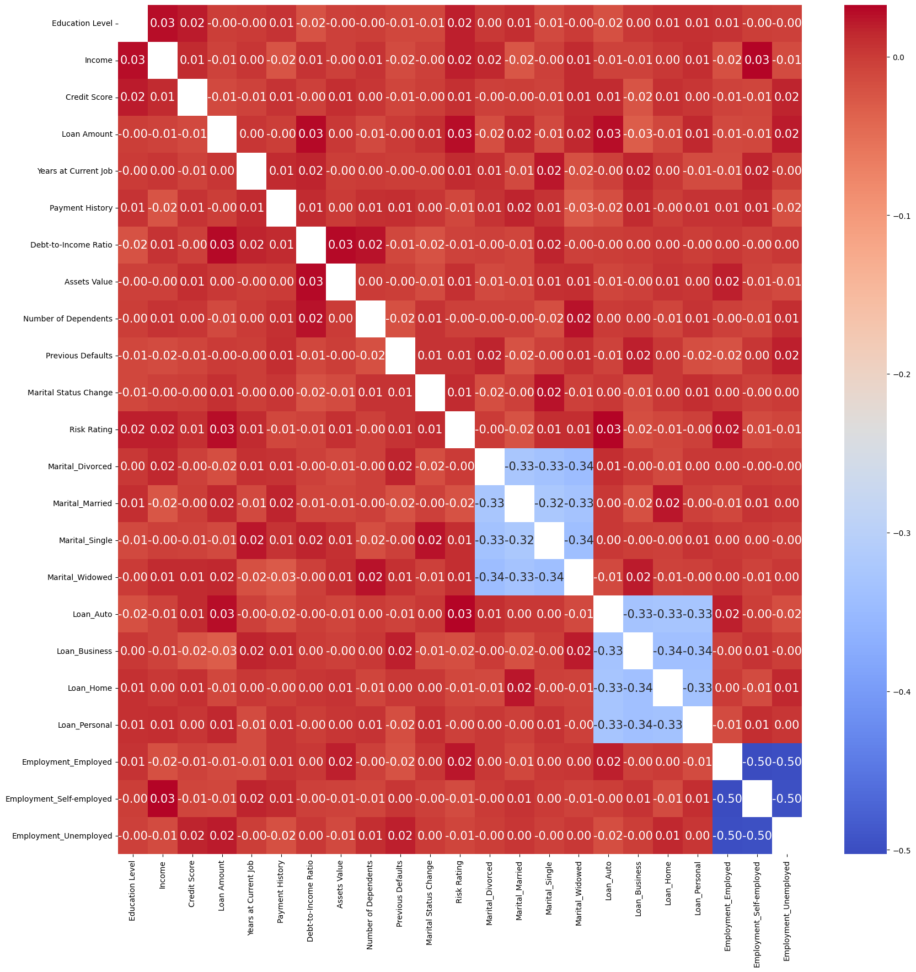
Correlation Analysis
Generate and visualize a heatmap of the correlation matrix
Drop highly correlated or redundant features
From the heatmap, it can be observed that there is almost no significant correlation among the features (correlation coefficients are close to 0), indicating that these features are relatively independent. Moreover, the correlation between these features and the target variable Risk Rating is also very low, suggesting that the current features have limited power for risk rating.

Slide 9
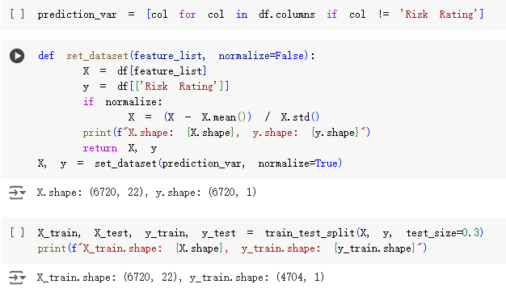
Modeling
Splitting the datasets into a training set and a testing set
We choose 70% as the train dataset, 30% as the test dataset

Slide 10
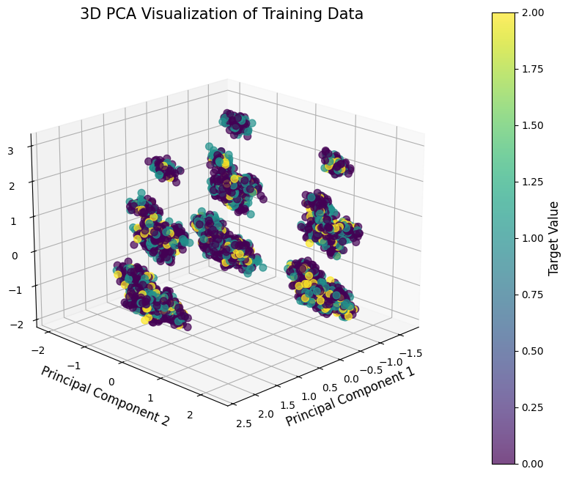
Dimensionality Reduction
PCA3D

Slide 11
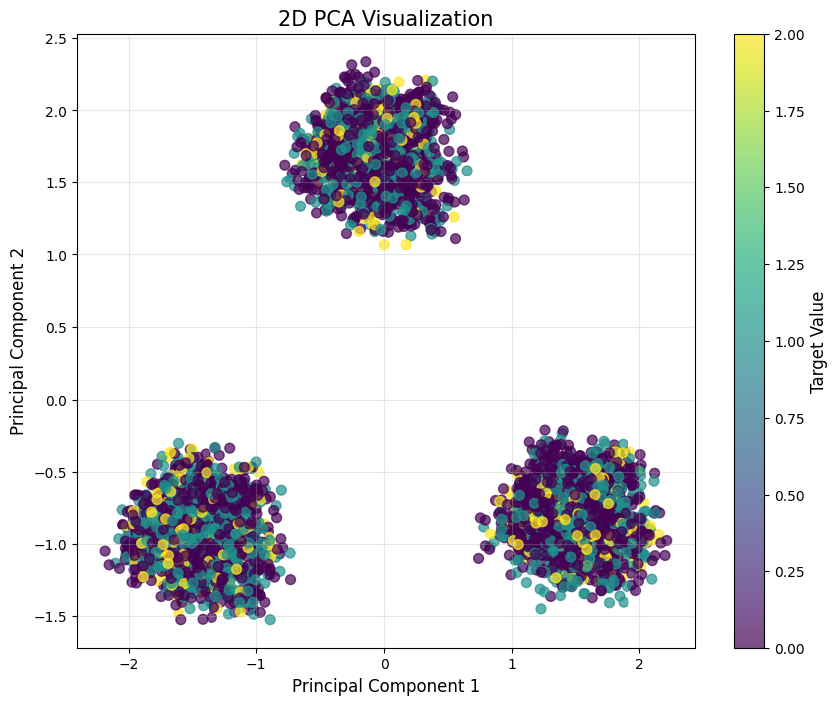
Dimensionality Reduction
PCA2D

Slide 12
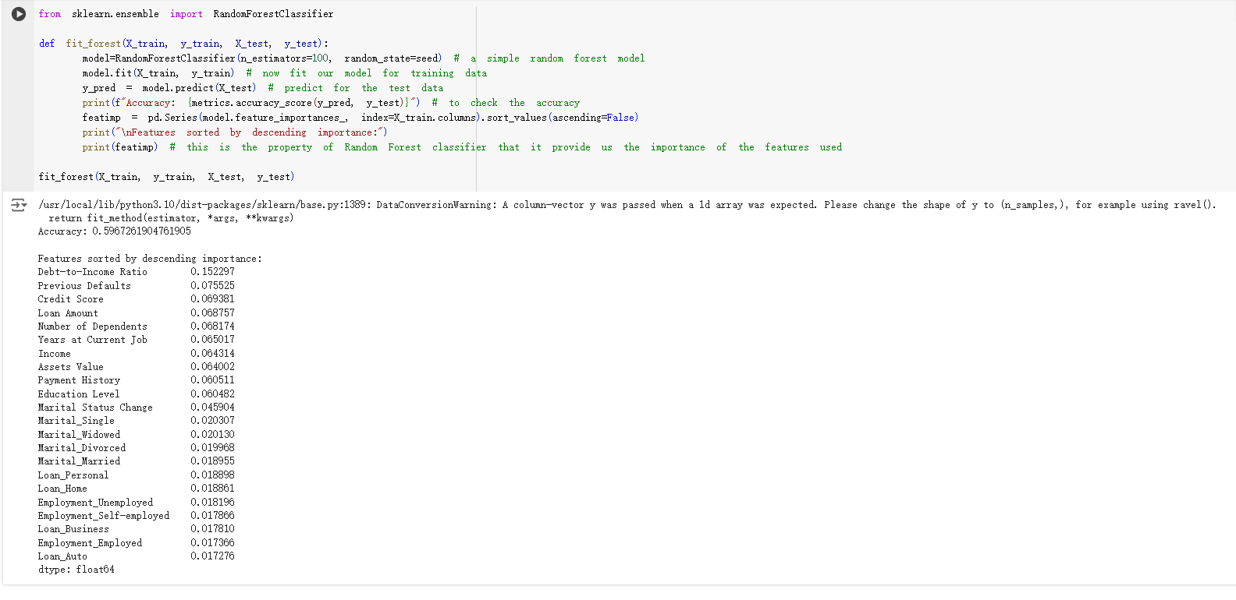
Modeling
Random Forest

Slide 13
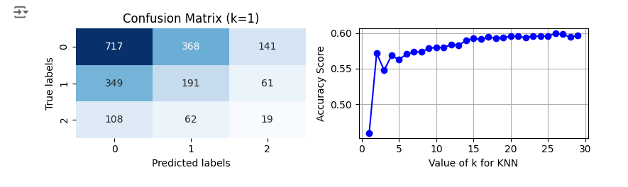
Modeling
k-Nearest Neighbors (kNN) Model

Slide 14
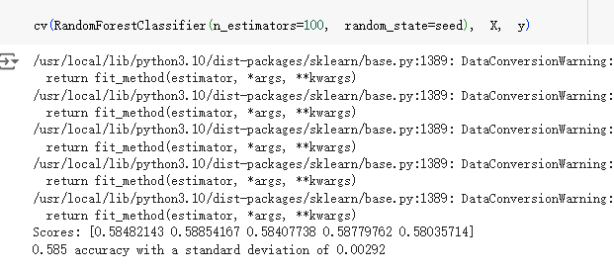
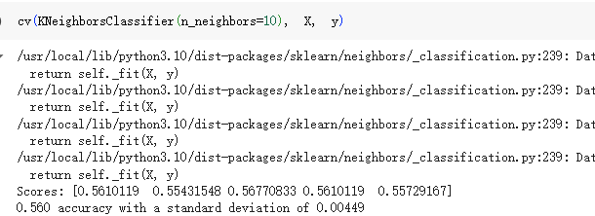
Cross-Validation

Slide 15
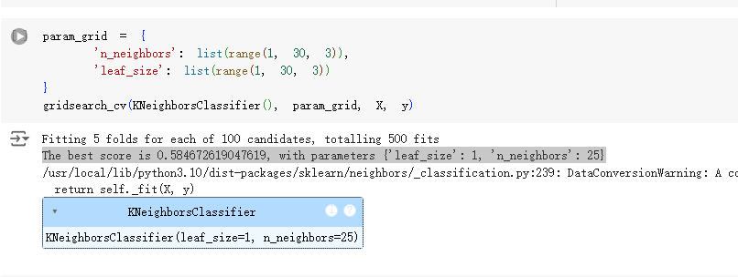
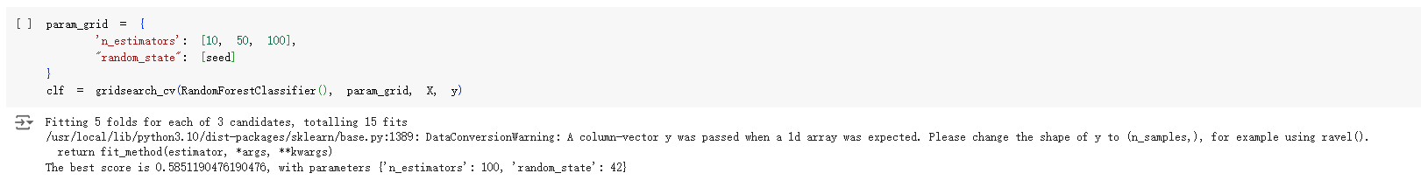
Hyperparameter Tuning

Slide 16
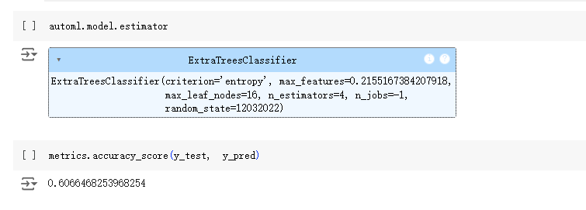
AutoML

Slide 17
Conclusion
Weak Feature Correlation: Weak correlations with the target variable highlight the need for enhanced feature engineering or external data integration to improve predictions.
PCA Limitations: PCA revealed data structure but failed to capture complex relationships
Potential for Model Optimization: Despite hyperparameter tuning and AutoML optimization, the overall model accuracy remains limited.

